Slide 1

Introduction to Cloud Computing and Azure DevOps
Cloud, Resource Groups,Vnet,Vm, Repos, Classic Pipelines & YAML Pipelines.
Name: S.N.S.S.RUTWIK
DATE:27/09/24

Slide 2
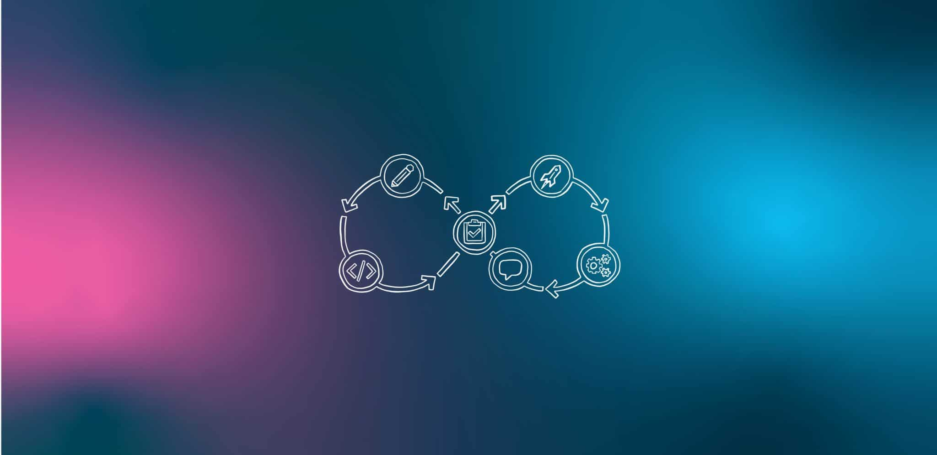
cloud computing :
History before cloud providers like azure,aws & etc:
when we look back into the olden days of deploying of the web application or apps. where we need to purchage the server and we need to invest,maintenance of that server.
Buying is a server is very much cost and the maintenance is also costly. if our application is not reached to our expectations . what ever we bought is wast of money.
So in order to over come all this issues the cloud providers came into the action.they will provide us servers for rent.So we can use there servers and services .can pay in the form of rent.
aws,azure and gcp and other most use the term called pay-as-you-go.
Cloud computing refers to the delivery of computing services over the internet (“the cloud”), allowing users to access and use shared resources, such as servers, storage, databases, networking, software, and analytics, without direct management from users. Instead of relying on local servers or personal devices, users can leverage remote servers hosted in data centers, typically managed by third-party providers.
Benefits:
- Cost Efficiency
- Scalability
- Accessibility

Slide 3
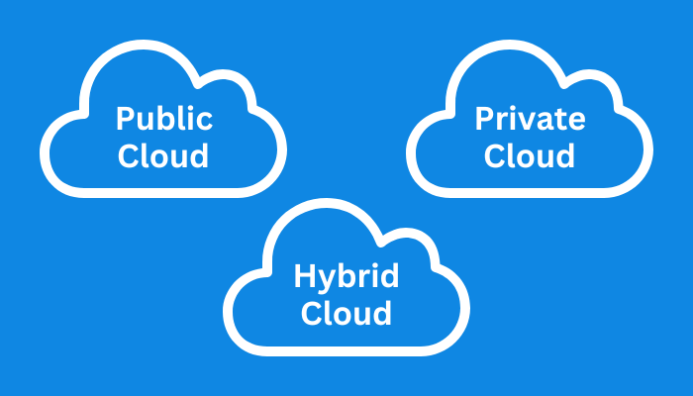
There are three main types of cloud:
public cloud : A public cloud is a computing model that allows individuals and organizations to access computing services over the internet through third-party providers. These services can include storage, applications, and develop-and-deploy environments.
private clouds: The private cloud is defined as computing services offered either over the Internet or a private internal network and only to select users instead of the general public.
hybrid clouds: A hybrid cloud is a computing environment that combines an on-premises data center (private cloud) with a public cloud, allowing data and applications to be shared between them.

Slide 4
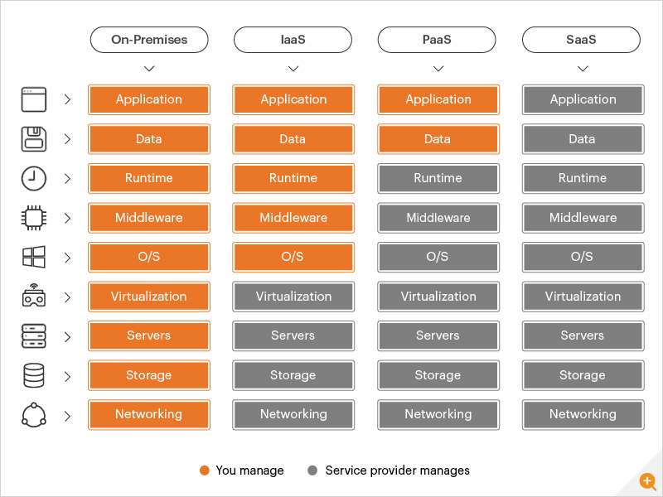
types of cloud computing services:
1.Infrastructure as a Service (IaaS):
IaaS provides virtualized computing resources over the internet, including virtual machines, storage, and networks. Users can rent IT infrastructure on a pay-as-you-go basis, eliminating the need for physical hardware.
2. Platform as a Service (PaaS):
PaaS provides a platform allowing developers to build, deploy, and manage applications without worrying about the underlying infrastructure. It typically includes development tools, databases, middleware, and more.
3. Software as a Service (SaaS):
SaaS delivers software applications over the internet, allowing users to access the software via a web browser without needing to install or maintain it on their local devices. It often operates on a subscription model.
4. On premises :
On-premises, or "on-prem", refers to a computing infrastructure or software that is installed and operated locally on a company's own hardware and servers.

Slide 5
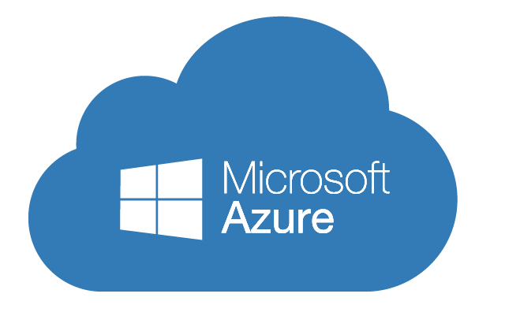
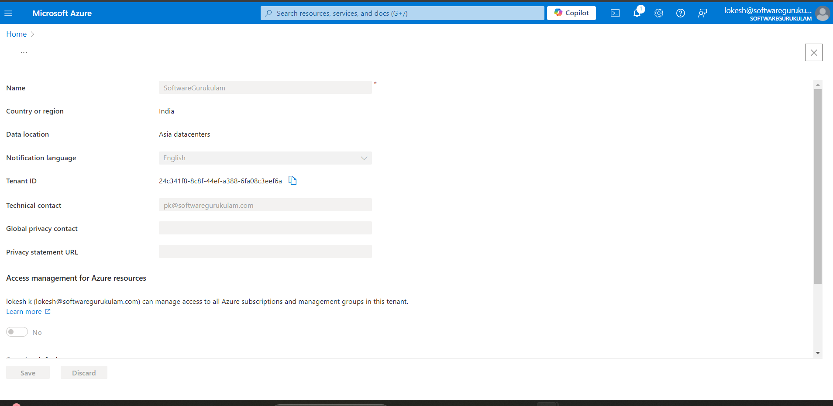
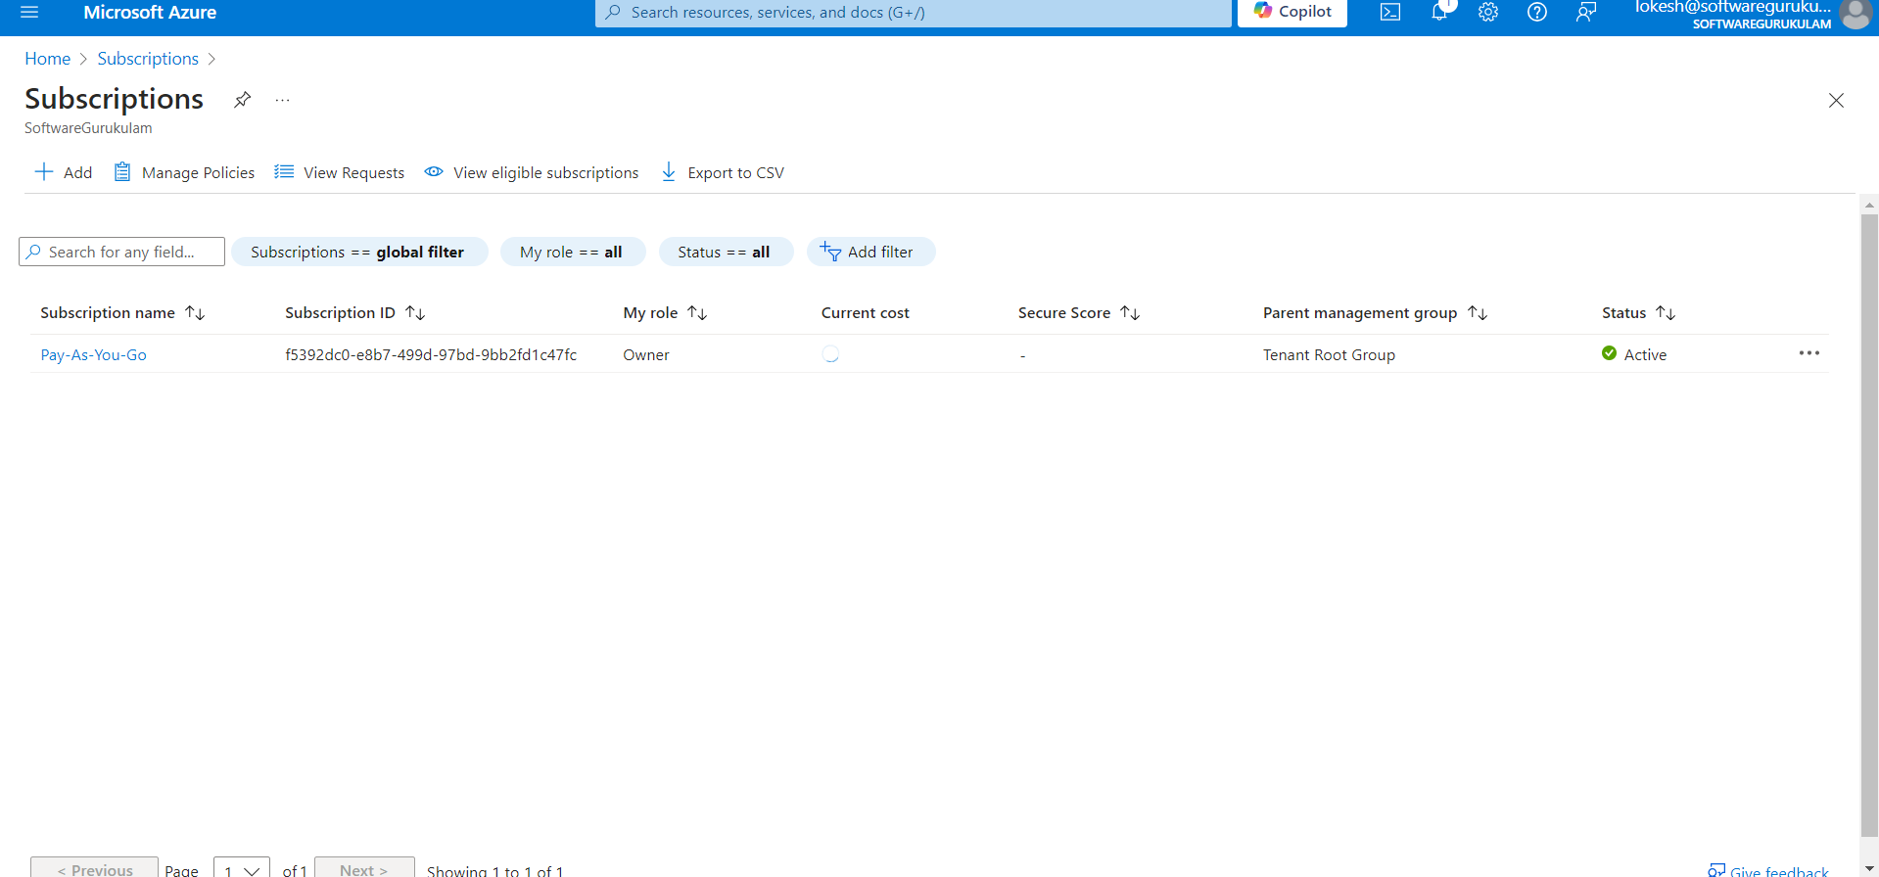
Introduction to Azure : Azure is a cloud computing platform by Microsoft that enables businesses to build, deploy, and manage a wide range of applications and services through Microsoft-managed data centers across the globe.
Tenant in azure:
A tenant in Azure is a Microsoft Entra ID entity that represents an organization, identity, or person. It's a digital representation of your organization and is primarily associated with a domain, like Microsoft.com.
Azure Subscription:
A subscription is a logical container used to provision and manage Azure resources. It's tied to a billing account and helps manage access, costs, and resource organization.

Slide 6
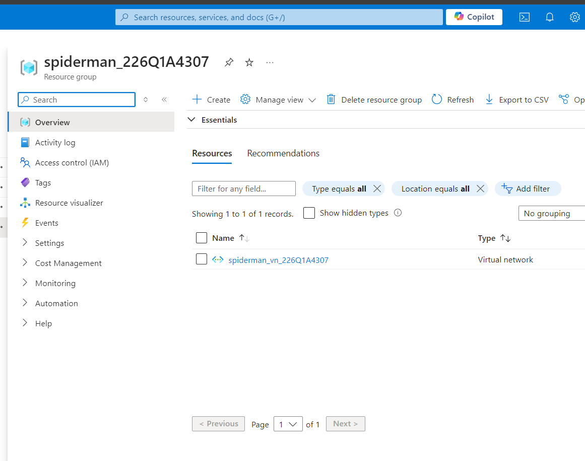
Azure Resources: These are the individual services provided by Azure, such as Virtual Machines (VMs), SQL Databases, Storage Accounts, etc. Each resource is deployed and managed independently within a resource group.
Resource Groups:
A resource group is a container that holds related resources for an Azure solution. It helps manage and organize resources like virtual machines, storage accounts, and databases based on their lifecycle and permissions.
Steps of creation of reasource group:
To create a resource group in Azure, follow these steps:
Navigate to the Azure portal and log in to your account.
In the left-hand menu, click on "Resource groups."
Click on the "Create resource group" button.
Fill in the details for the resource group, such as the subscription, resource group name, and region.
Click on "Review + create" to review the details, and then click "Create" to create the resource group.

Slide 7
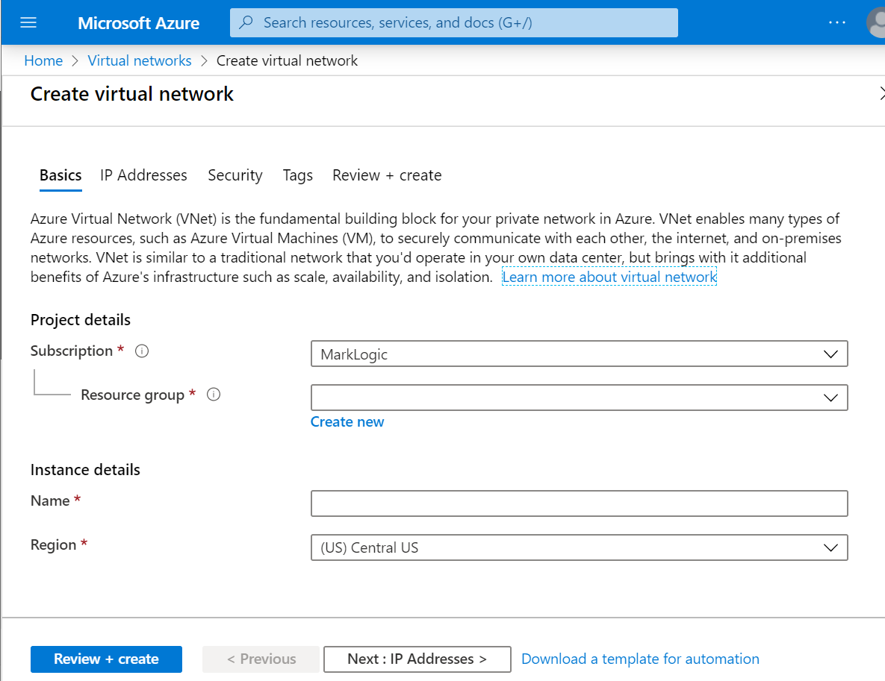
Azure vnet: In Azure, a Virtual Network (VNet) is a logical isolation of the Azure cloud dedicated to your subscription. It allows you to securely connect Azure resources, such as virtual machines, within a virtual private network and provides various options for networking, security, and communication.
Steps to create the vnet:
• Log in to Azure Portal: Go to the Azure Portal and log in with your credentials.
• Navigate to Virtual Networks: In the left-hand menu, search for and select "Virtual Networks."
• Create a New VNet:
.Click on "Create" at the top of the Virtual Networks page.
Choose a Subscription and Resource Group (create a new one or select an existing one).
• Configure Basics:
Name: Enter a name for your VNet.
Region: Select the region where you want your VNet to be created.
IP Address Space: Define the address space using CIDR notation (e.g., 10.0.0.0/16).
• Add Subnets:
You can define subnets within your VNet. Each subnet gets its own portion of the IP address space (e.g., 10.0.1.0/24).
You can configure multiple subnets for different Azure resources.
• Configure Security and Connectivity Options (Optional):
You can add Network Security Groups (NSGs) to manage inbound/outbound traffic.
Choose whether to connect your VNet to an on-premises network using VPN Gateway or ExpressRoute.
Review and Create: After configuring all the necessary settings, review your setup, and click Create.

Slide 8
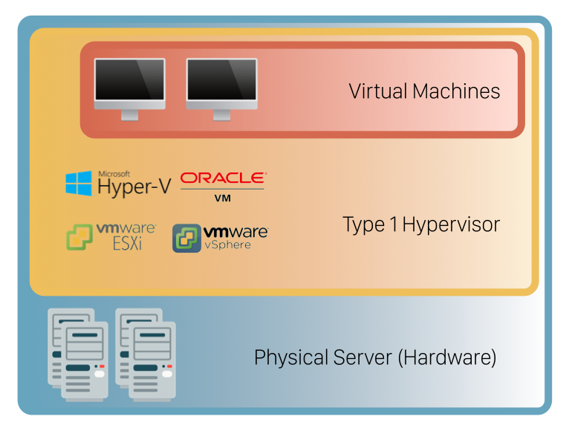
virtual machine (VM): A virtual machine (VM) is a software-based computer that acts like a physical computer, allowing you to run programs and operating systems on it.
Steps to create vm:
Enter virtual machines in the search.
Under Services, select Virtual machines.
In the Virtual machines page, select Create and then Azure virtual machine. The Create a virtual machine page opens.
Under Instance details, enter myVM for the Virtual machine name and choose Windows Server 2022 Datacenter: Azure Edition - x64 Gen 2 for the Image. Leave the other defaults.
5.Under Administrator account, provide a username, such as azureuser and a password. The password must be at least 12 characters long and meet the defined complexity requirements.
6.Under Inbound port rules, choose Allow selected ports and then select RDP (3389) and HTTP (80) from the drop-down.
7.Leave the remaining defaults and then select the Review + create button at the bottom of the page.
8.After validation runs, select the Create button at the bottom of the page.
After deployment is complete, select Go to resource.

Slide 9


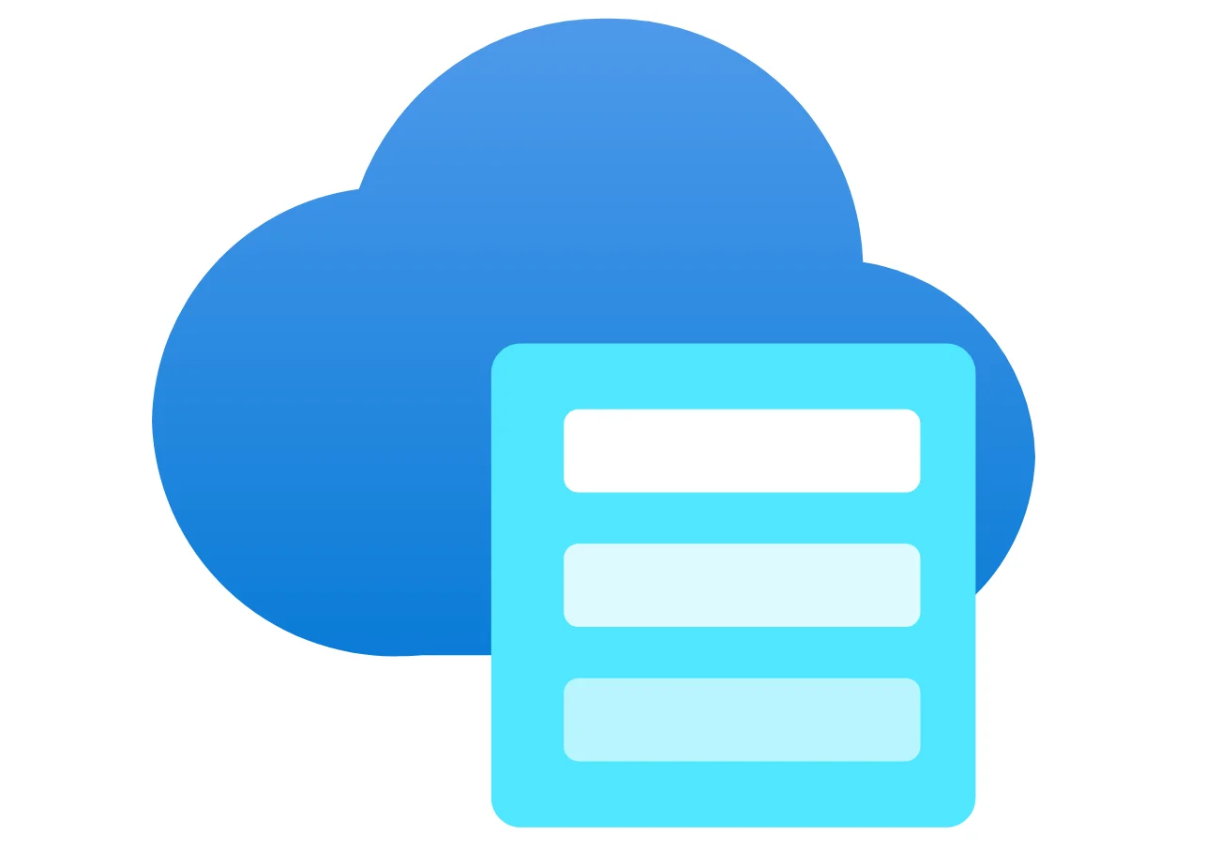
Introduction to Azure Key Vault: Azure Key Vault is a cloud service designed to securely store and manage sensitive information such as API keys, passwords, certificates, and cryptographic keys. It provides a centralized location for managing secrets that can be accessed by applications and services securely and conveniently.
Azure Storage Account:
An Azure Storage Account is a container that holds various Azure storage services such as blobs, files, queues, tables, and disks.
Key Types of Storage Accounts:
Blob Storage: For storing unstructured data like images, videos, and documents.
File Storage: Managed file shares accessible via the SMB protocol.
Queue Storage: For building messaging queues to facilitate asynchronous communication between components.
Table Storage: A NoSQL key-value store optimized for fast data access.
Disk Storage: Persistent storage for Azure Virtual Machines.
Azure App Service:
Azure App Service is a fully managed platform-as-a-service (PaaS) offered by Microsoft Azure for building, deploying, and scaling web applications, RESTful APIs, and mobile backends. It abstracts the complexity of infrastructure management, allowing developers to focus on application development without worrying about the underlying servers, operating systems, or runtime environments.

Slide 10
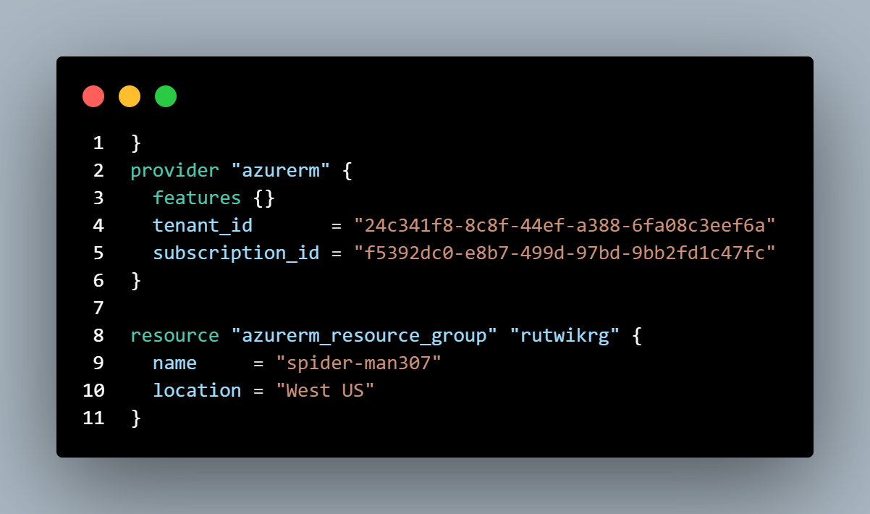
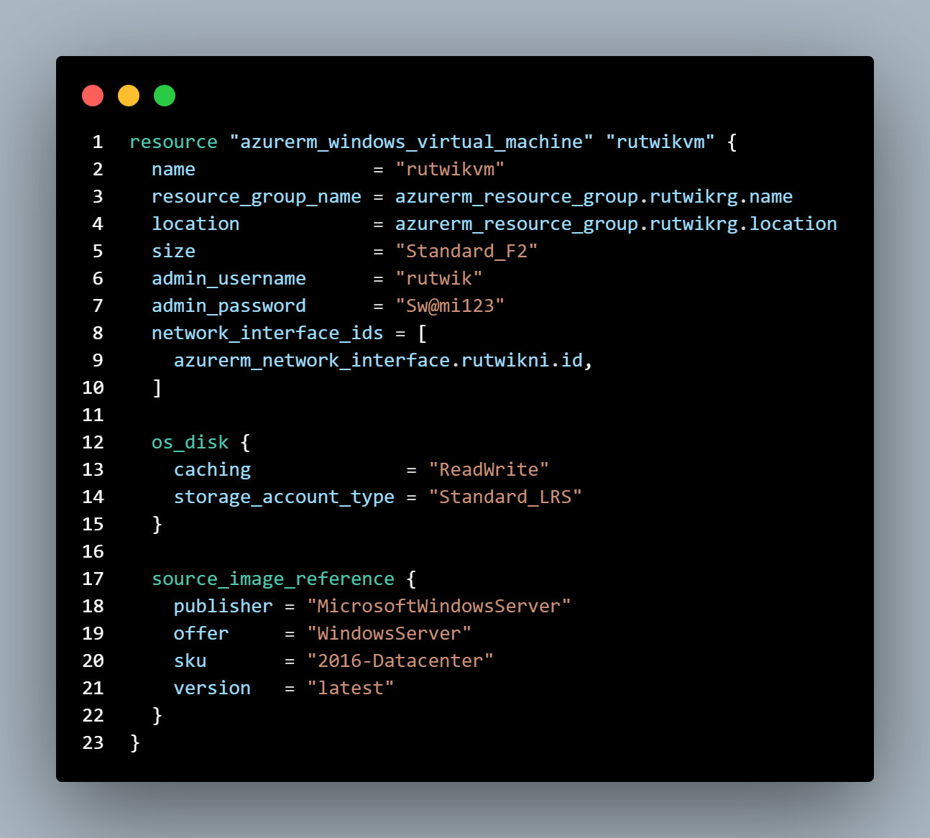
Day:2 Terraform: Terraform is an open-source tool that allows users to build, change, and manage infrastructure as code (IaC). It uses a high-level configuration language called HashiCorp Configuration Language (HCL) to describe the desired state of infrastructure. .
TERRAFORM BASIC CMD:
terraform init: Initializes a working directory containing Terraform configuration files. This command downloads the necessary provider plugins and sets up the backend.
terraform plan: Generates an execution plan, showing the actions Terraform will take to reach the desired state as defined in the configuration files. This is useful for understanding what will change before applying changes.
terraform apply: Applies the changes required to reach the desired state of the configuration. This command creates, updates, or destroys resources as necessary.
terraform destroy: Removes all resources defined in the Terraform configuration files, effectively tearing down the infrastructure.

Slide 11
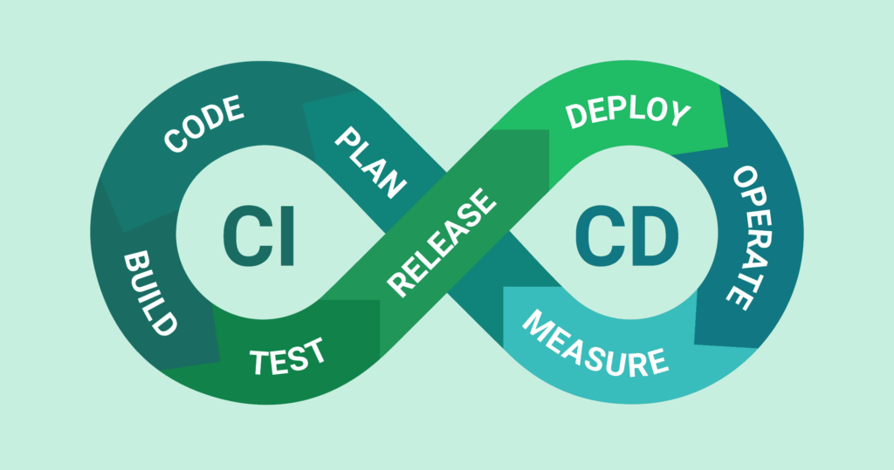
pipeline: In general, a pipeline in DevOps is a set of automated processes that allow for continuous integration (CI) and continuous delivery (CD). This includes stages for building, testing, and deploying software, and can also encompass phases related to procurement, order processing, and supply chain management when dedicated to purchasing.
Components : -
Build Pipelines: Compile code, run tests, package applications
Release Pipelines: Deploy applications to different environments (dev, test, production)
Benefits:
Faster delivery of features
Reliable deployment processes
Automated testing
Types of Pipelines:
1.Classic Pipelines
2. YAML Pipelines

Slide 12
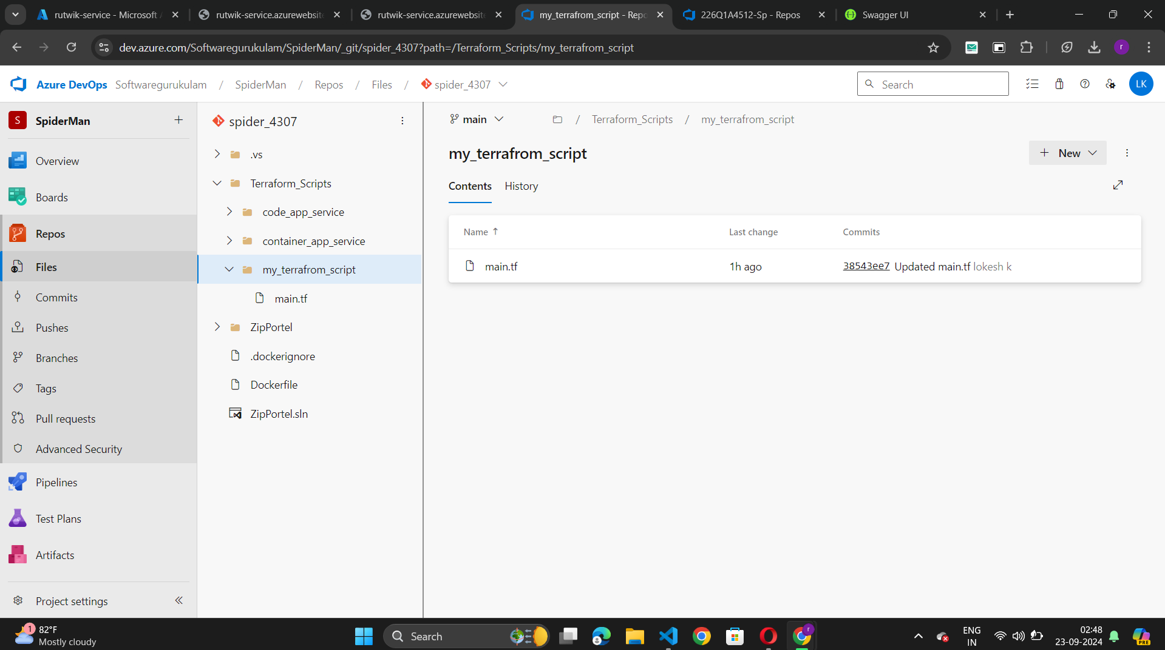
Day:3 Cloning a GitHub Repository in Azure DevOps:
1.Locate Your Azure DevOps Project:
Open your Azure DevOps organization and navigate to the specific project where you want to clone the repository..
2.Create a New Repository:
Navigate to Repos > Files.
Click on New repository to create an empty repository if you haven't created one
3.Clone the GitHub Repository:
In the Repos section, use the Import Repository feature:
Click on the drop-down arrow next to New repository and select Import repository.
Paste the GitHub repository URL (e.g., https://github.com/username/repository.git) in the Clone URL field.
Azure DevOps will use the service connection to authenticate, so if it’s a private repository, make sure you have the necessary access.
Click Import to start the cloning process.
6.Verify the Clone:
After the import is complete, navigate back to Repos > Files, and you should see the contents of the cloned repository.
Git:
Git is a distributed version control system used to track changes in source code during software development. It allows multiple developers to collaborate on a project by keeping a history of changes, managing different versions of the code, and enabling team members to work on the same project simultaneously.

Slide 13
Classic Pipelines: These are also known as "Visual Designer" pipelines. Classic pipelines use a graphical user interface (GUI) for creating and managing build and release pipelines. Users interact with a drag-and-drop interface to define the steps and stages of the pipeline. They are generally more user-friendly for those who prefer not to write code, making them suitable for simpler projects or teams new to CI/CD practices.
Configure Build Pipeline:
Release Pipeline Setup:
Deployment Stage Setup:
Pipeline Name: Name your pipeline and set build retention (optional).
Add Build Steps:
.NET Core/Visual Studio Build:
Search for and add the task.
Set Command to Build Release Pipeline Setup
and specify your solution file (e.g., YourProject.sln).
Run Tests:
Add another .NET Core or Visual Studio Test task.
Set Command to Test.
Publish Artifacts:
Search for and add Publish Build Artifacts.
Set Path to Publish (e.g., $(Build.ArtifactStagingDirectory)).
Set Artifact Name (e.g., "drop").
Navigate to Releases: Go to the Pipelines tab and select Releases.
Create Release Pipeline: Start a new release pipeline with an empty template.
Add Artifact: Link the artifact from your build pipeline by selecting Add an artifact.
Add Stages:
Terraform Stage: Create a stage for deploying infrastructure using Terraform tool install, Terraform init, plan and apply
Add Web Publisher Task:
Add the Azure App Service Deploy task:
Set Azure subscription and App Service name.
Specify the package or folder path to publish.

Slide 14
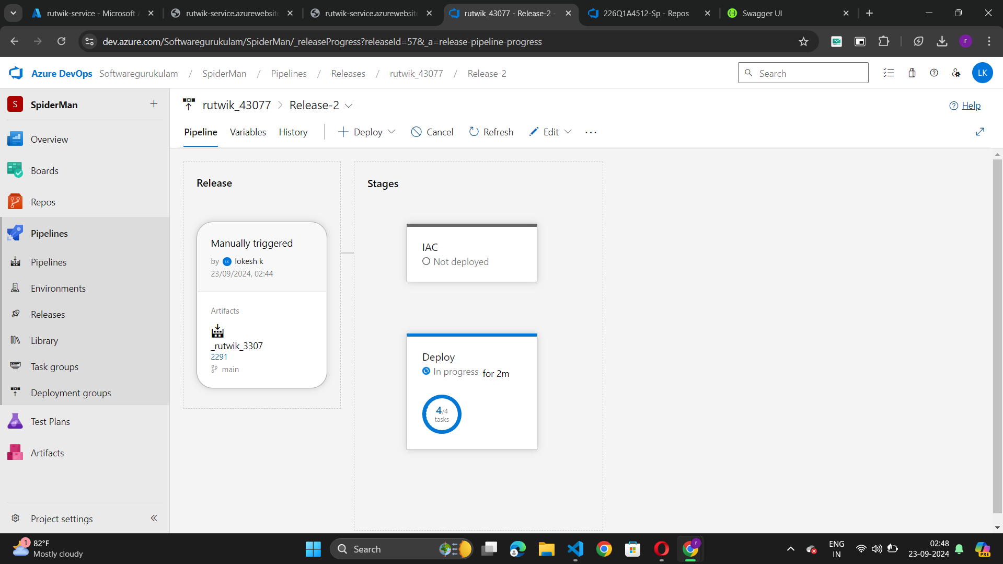
Release Pipeline
Deployment Stage
Build Pipeline

Slide 15
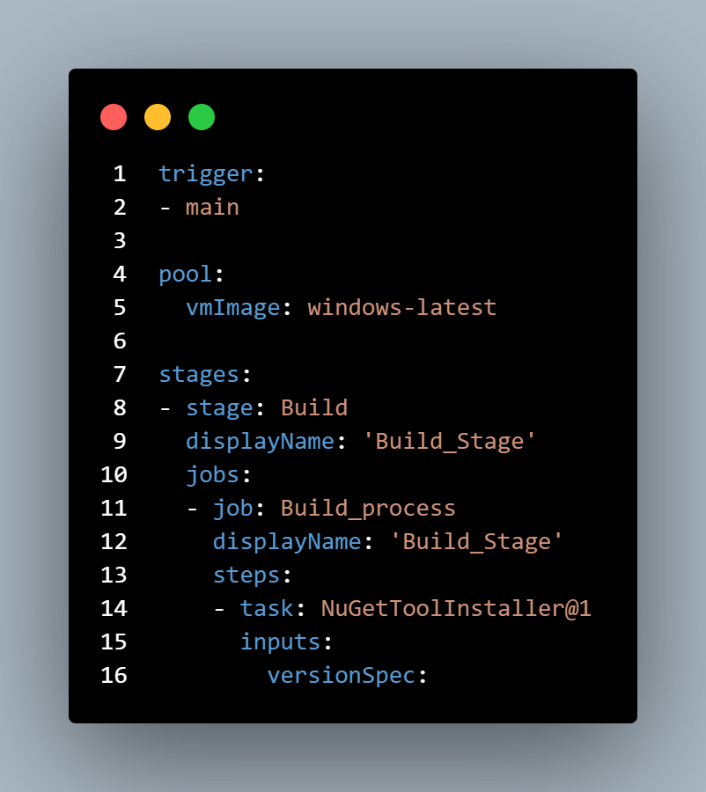
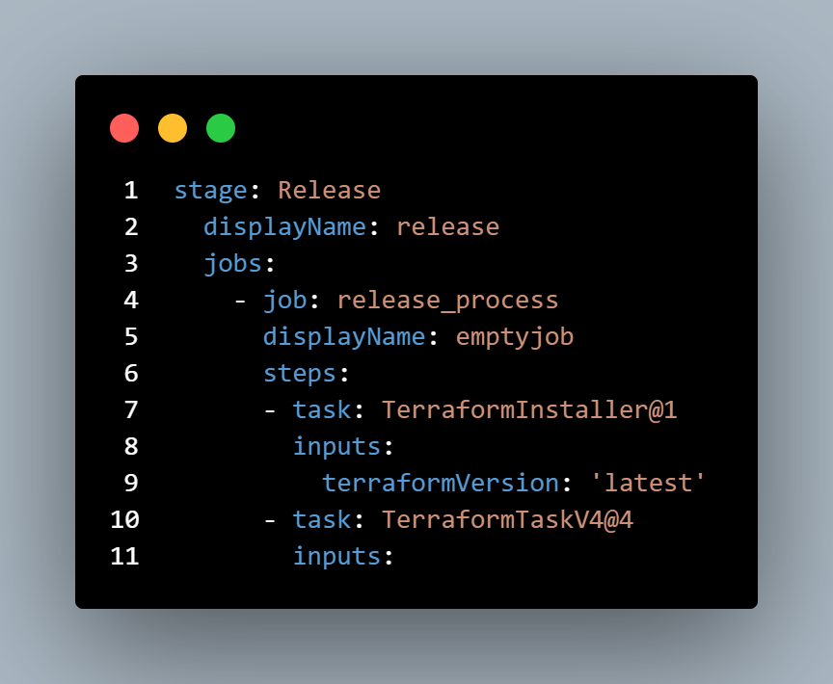
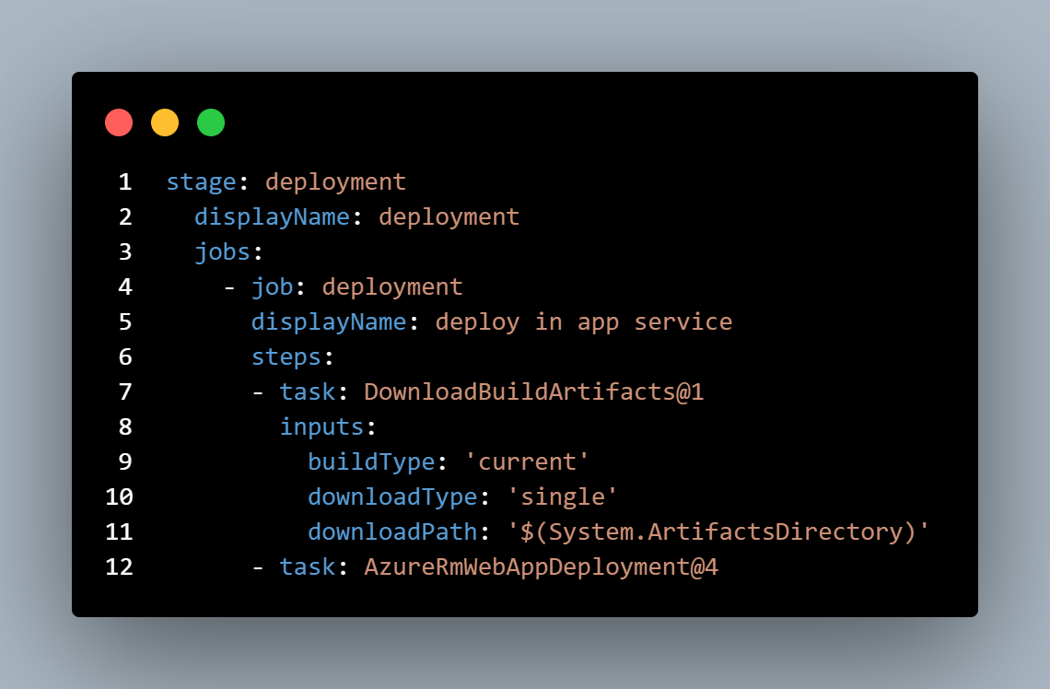
Day:4 YAML Pipelines: Yaml Often referred to as "Pipeline as Code," YAML pipelines allow users to define the entire pipeline in a YAML file. This file can be versioned alongside the application code, providing better collaboration and history tracking. hey are favored for more complex workflows and offers advantages like code reuse, clearer version history, and easier branching strategies, which enhance collaboration among teams.

Slide 16
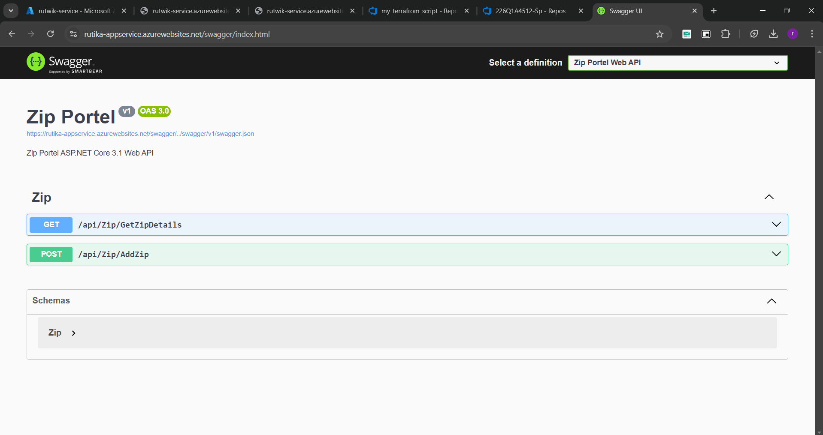
Deployed web page

Slide 17
advantages and disadvantages
Classic Pipelines:
YAML Pipelines:
Advantages:
User-Friendly Interface: Provides a graphical, drag-and-drop interface, making it easy for beginners to set up pipelines.
Faster Setup: Ideal for quick, simple pipeline creation without needing to write code.
Disadvantages:
Limited Flexibility: Customizing the pipeline for complex scenarios can be difficult due to the GUI limitations.
No Version Control: Pipeline configurations aren’t stored as code, so changes can't be tracked in version control systems.
Advantages:
Pipeline-as-Code: Pipelines are stored as code, enabling version control and easier collaboration.
High Flexibility: Supports complex workflows, conditions, and customizations that are harder to achieve in Classic Pipelines.
Disadvantages:
Steeper Learning Curve: Requires knowledge of YAML syntax, which can be challenging for beginners.
No Visual Overview: Lacks a graphical interface, making it harder to visualize and debug the pipeline compared to Classic Pipelines.

Slide 18
Conclusion:
Cloud computing and Azure provide scalable, reliable infrastructure for applications.
Azure DevOps enables teams to collaborate, manage code in Repos, and automate deployment with Pipelines.
YAML pipelines bring flexibility and maintainability to DevOps processes.

Slide 19
thankyou

